Slide 1
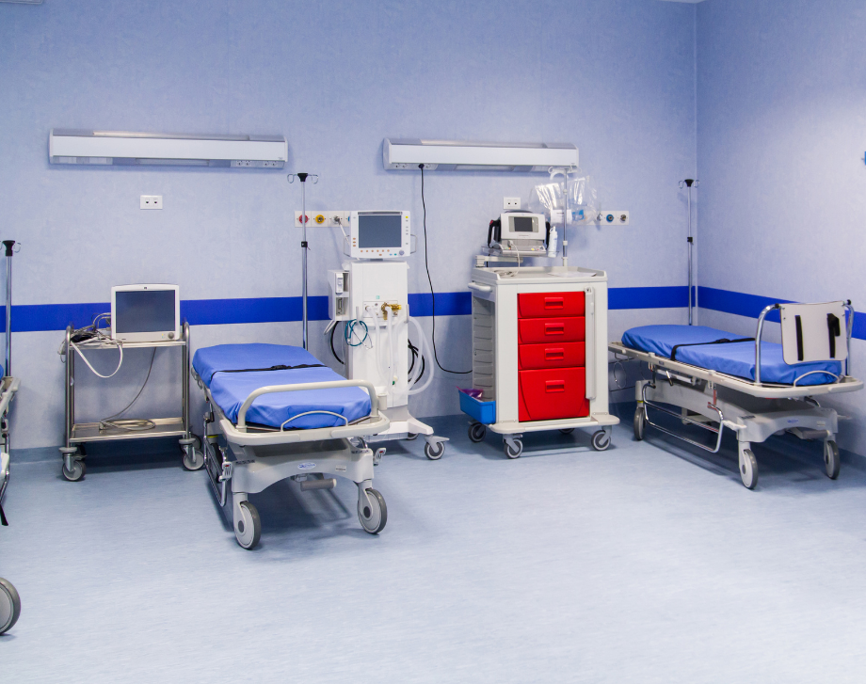
HYDROLIQ NON-HAZARDOUS AIR DISINFECTION FOR HEALTHCARE FACILITIES
PRESENTED BY
LIZ NYOKABI
JANST HEALTHCARE INTERNATIONAL LTD

Slide 2
Problem Statement

Slide 4
Challenges of our time
Other bleach solutions should be left for at least 2 minutes before being wiped for it to be effective as for hydroliq the effectiveness is instant
You can’t mix the bleach (disinfectant) with ammonia (cleaner) the mixture produces poisonous gas
Other traditional disinfectants poses risk to pediatric environmental health and are not safe for use on food contact surfaces
When using some air and surface disinfectants, you have to ventilate the room by opening windows to bring in outside air, turn on the fan etc

Slide 5
The Solution

Slide 7
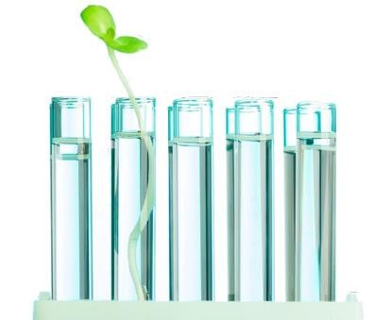

Slide 8
What it is.....

Slide 9
What it is.....
Hydroliq Pure Water disinfectant, a Swiss Biotechnology product that has the ability to eliminate viruses, multi-resistant bacteria, spores and fungi within a very short time
It is in liquid form but when put in a machine it turns into a mist
It goes into a hidden places/angles
It works without alcohol, without synthetic additives and can be used in presence of humans without any health risks
It is dispersed with nebulizers /humidifiers and eliminates pathogens in the air and can also be used as a hand sanitizer or surface disinfectant

Slide 10
What it is.....
With hydroliq pure water disinfectant, we guarantee you over 1 year efficacy once you open the bottle as it doesn’t lose strength on opening, hence you don’t have to replace it every few months
It’s effectiveness is instant; once you apply, you don’t have to wait for two minutes before wiping
It doesn’t wet surfaces
It is paediatric friendly
Safe to use on food contact surfaces

Slide 11
Highlighted problems in conventional infection control solutions
Safety – Can’t be applied in the presence of people, toxic residues
Affect mucous membranes and skin
Application – require PPEs
Effect on people & environment
Corrosion- metals, rubber and plastic materials
Storage – Loss of strength over time
Dangerous goods – strict regulations in handling and transportation
Financial Impact
Notes:
Alcohol based disinfectants are the most common ones. But besides that, there are other alternatives, such as Hydrogen Peroxide, Ultra Violet, Ozone, etc.
The problem with all of these alternatives is that they are either less effective, not ecologic or attacking mucous membranes and materials. As an example, it is not possible to disperse Hydrogen Peroxide or alcohol based disinfectants by nebulization in the presence of people, since this would be way to dangerous and may end up into serious health issues.
All our Hydroliq solutions are highly effective (this is has been proven by the Reports done by independent laboratories) and can be dispersed in the presence of humans (or animals) without any risks and hence also safe for paediatric use.
When using other conventional disinfectants, you have to wear PPEs during application and they are corrosive to metal ,rubber and plastic materials.
Conventional disinfectants gradually loses strength on opening the bottle so this means not as effective as required or fresh solutions has to be prepared daily and stock solutions has to be replaced every few months hence you acquire losses.

Slide 13
Guarantee safety for patients, healthcare workers, caregivers and visitors
Eliminate pathogens everywhere safely
Cost effective infection control
Protect the vulnerable
Protects your equipment and fittings

Slide 16
Hydroliq application
Air Disinfection
Room Disinfection
Equipment Disinfection
Surface Disinfection
Body Disinfection
Hand Disinfection

Slide 17
Disinfect
Wards
Waiting areas
Consultation rooms
Procedure rooms
Ambulances
Equipment
Corridors
Meeting rooms
Kitchen
Laundry areas
Beds
Storage

Slide 18
Certifications/Registration
Hydroliq conforms to all applicable WHO and European Chemicals Agency (ECHA) standards
Halal Certified
EPA
PPB

Slide 19
Countries in use
Germany
Austria
Spain
France
Sweden
Greece
Belgium
Netherlands
Luxemburg
Croatia, Norway, United Arab Emirates, Saudi Arabia, Turkey, Commonwealth of independent States (CIS), South Africa, India etc

Slide 20
Existing clients

Slide 21
Who we are

Slide 22
Janst Healthcare International Ltd
We have been in business for more than 20 years
We offer high level and cost effective disinfectants and continuous training, education combined with 24/7 customer service to ensure optimal use of our products
We understand that protection of HCWs and patients using health care facilities is of equal importance to the accuracy of data. Therefore applying effective infection prevention control procedures is vital. HCWs working with vulnerable population need to have confidence in infection prevention and control measures put in place to ensure best practice can be delivered

Slide 23
Janst Healthcare International Ltd
With hydroliq, we can be trusted by healthcare professionals around the country to achieve their goals in public health, HCWs protection and patient safety
Hydroliq air disinfectants is the appropriate solution for air disinfection, sterilisation of equipment, room disinfection &hand sanitization. This makes it easy to achieve health and safety compliance in healthcare sectors

Slide 24
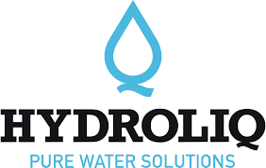
OUR FLAGSHIP PRODUCTS
Intersurgical Products
The leading supplier of respiratory care disposables, including high quality validated infection control products for ICU,theatre and other departments in the hospital
Medela Products
Swiss-made quality breast pumps (both manual and electric and its accessories)

Slide 25
Complete respiratory care

Slide 27
Below are two very short video extracts, in order to give you an idea on how the liquid solutions are dispersed. One is about the complete disinfection of vehicle interiors, including odor elimination (done by our customer). The second one is illustrating how funiculars in tourist areas are using it (of course this can be used in a similar manner for many other areas of application):

Slide 28
More videos
Below is the link for two more field of applications:
https://www.youtube.com/watch?v=k_amXl3nL48
https://www.youtube.com/watch?v=Ic6eMRBtZIU&t=10s

Slide 29
Declaration of composition from manufacturer
For Hydroliq AIR
Composition/information on ingredients
Name Purified water | ldentificator | Ratio% 99.9676 | Function Active substance
Sodium chloride | CAS No. 7647-14-5 | 0.0150 | Active substance
 | EC No. 231-598-3
Active chlorine | EC No. 100-100-0 | 0.0150 | Produced by electrolysis
 | BAS No. 1236 |  | (production process),
 |  |  | not active substance
Sodium hypochlorite | CAS No. 7681-52-9 | 0.0012 | Produced by electrolysis
 | EC No. 231-668-3 |  | (production process), not active substance
Hypochlorus acid | CAS No. 7790-92-3 | 0.0009 | Produced by electrolysis
 | EC No. 232-232-5 |  | (production process),
 |  |  | not active substance
Chlorine | CAS no 7782-50-5 | 0.0003 | Produced by electrolysis
 | EC No. 231-959-5 |  | (production process), not active substance

Slide 30
Declarations of composition and safety data sheets
For more information about our products, please visit our display table and leave your contacts with us and we will be glad to keep in touch with you

Slide 31
Q&A
www.hydroliq.co.ke
Thank you

